Slide 1
Wednesday - Message Web Application
Group Presentation

Slide 2
Group Member
Members: {zhou.liha, liu.bo2, chen.jiey, tong.xi}@husky.neu.edu
001302072 Lihang Zhou
001057068 Bo Liu
001398614 Jieying Chen
001306762 Xing Tong

Slide 3





Part 1:
Welcome Page
Part 3:
Chat Page
Part 5:
Back-End
THANK YOU!
Part 4:
Profile
Part 2:
Login Page

Slide 4
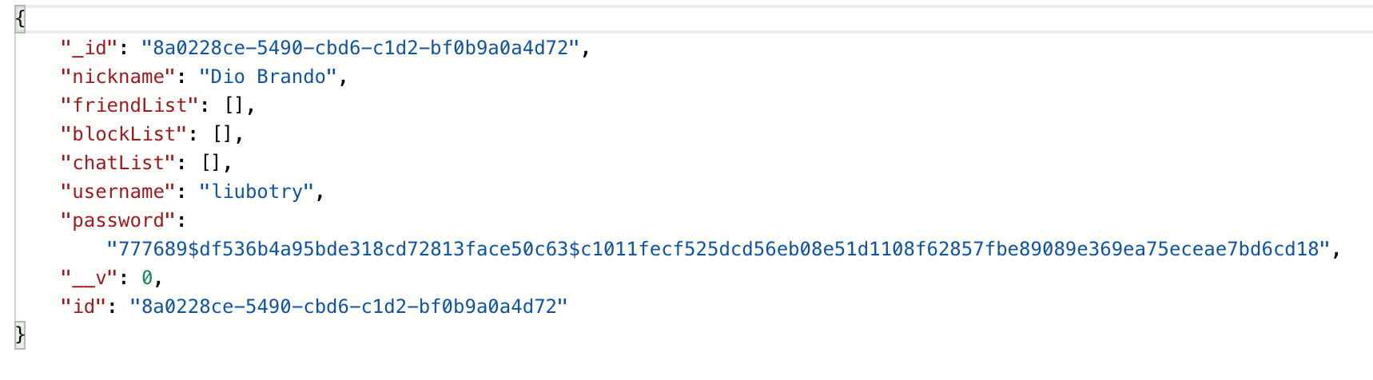
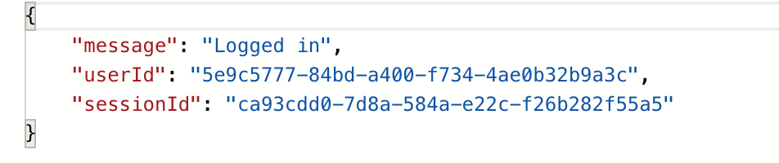
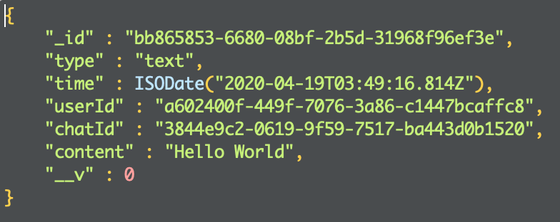
Data Structure
1.User Data Structure
· password is encrypted in the backend instead of plaintext.
2.Message Data Structure
·give new session Id while user log in every time.

Slide 5
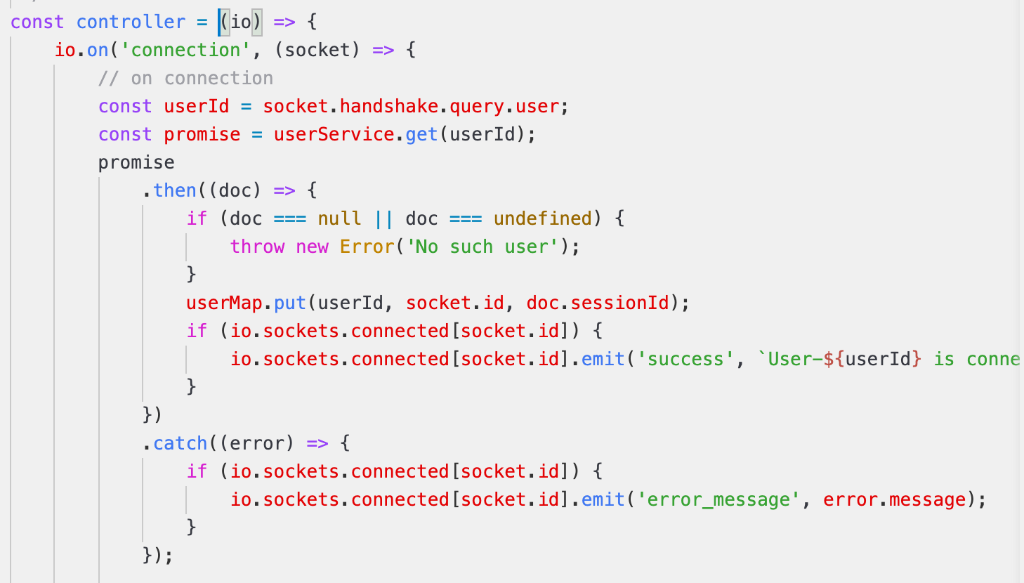
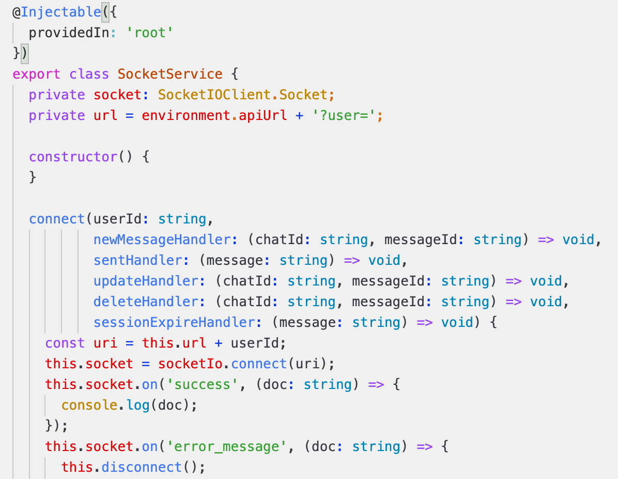
WebSocket
Server：
Client：

Slide 6
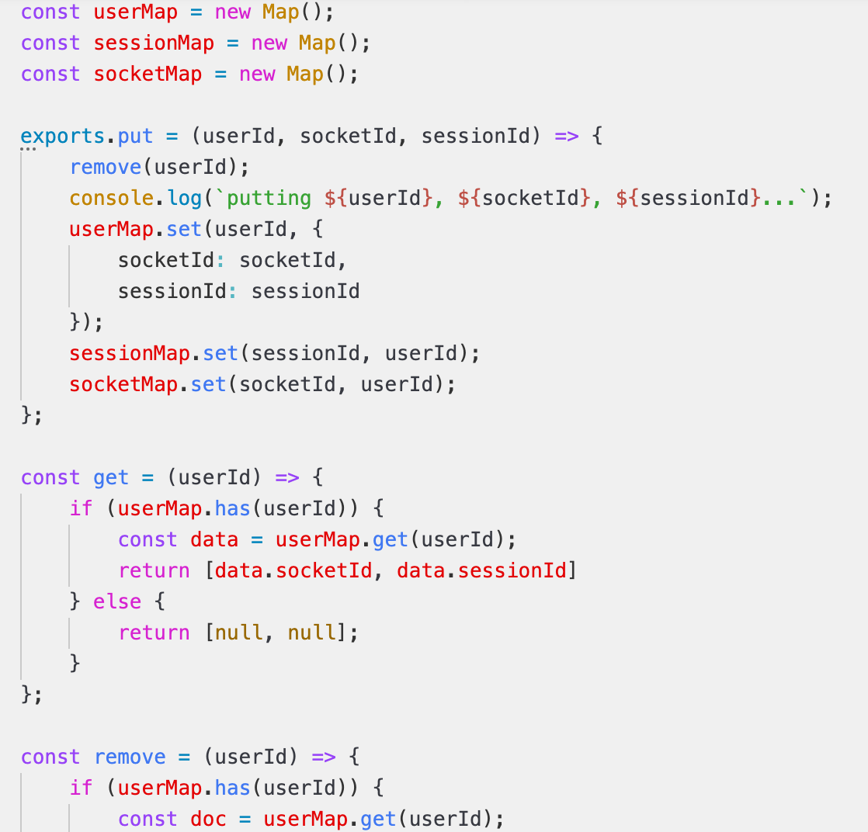
Map
Map:

Slide 7

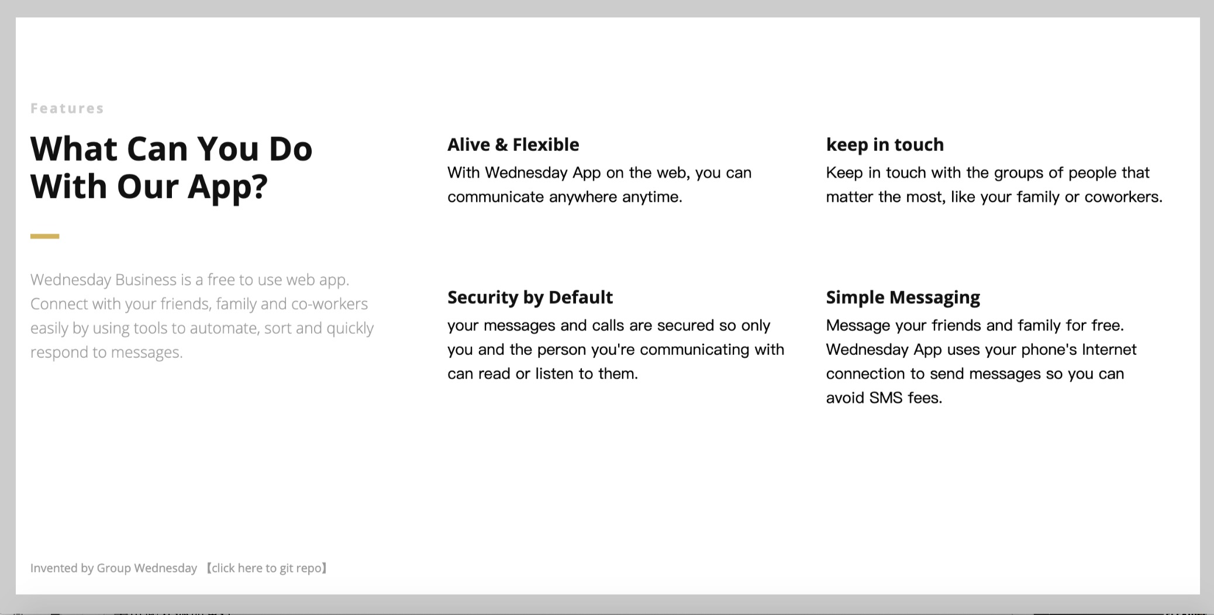
User Interface

Slide 8
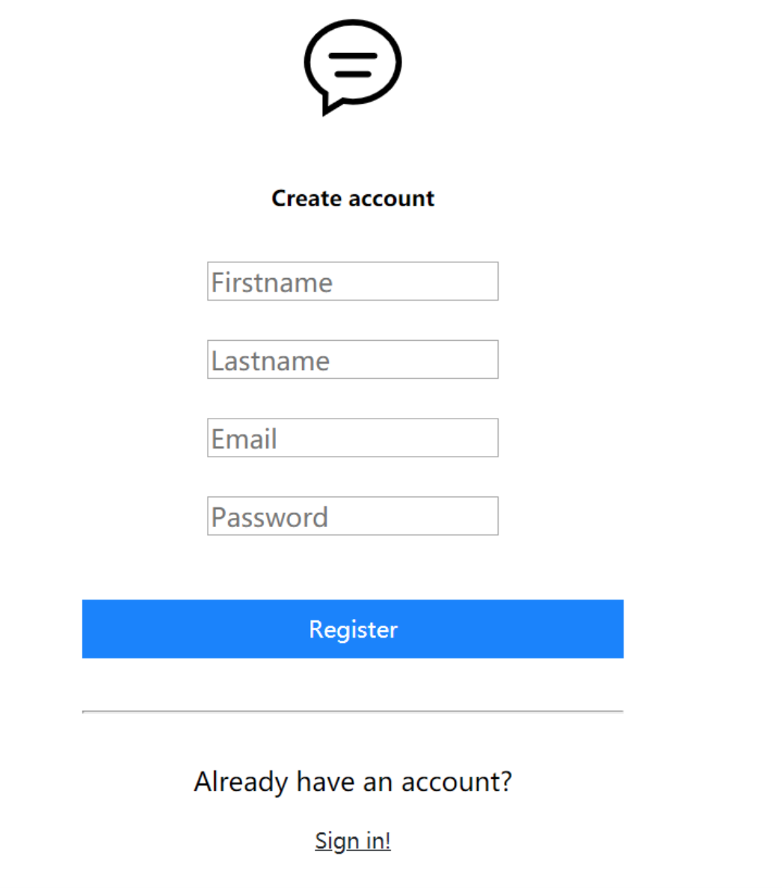
Login-page

Slide 9
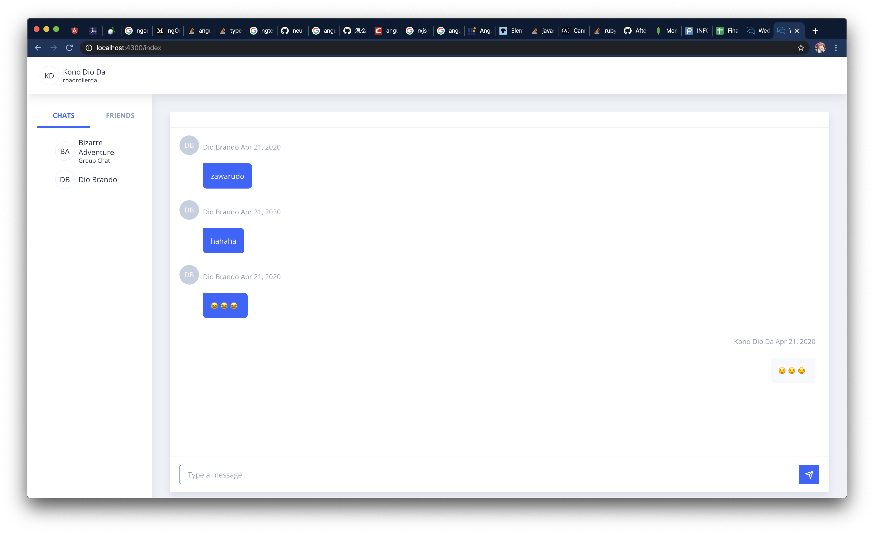
Chat-page

Slide 10
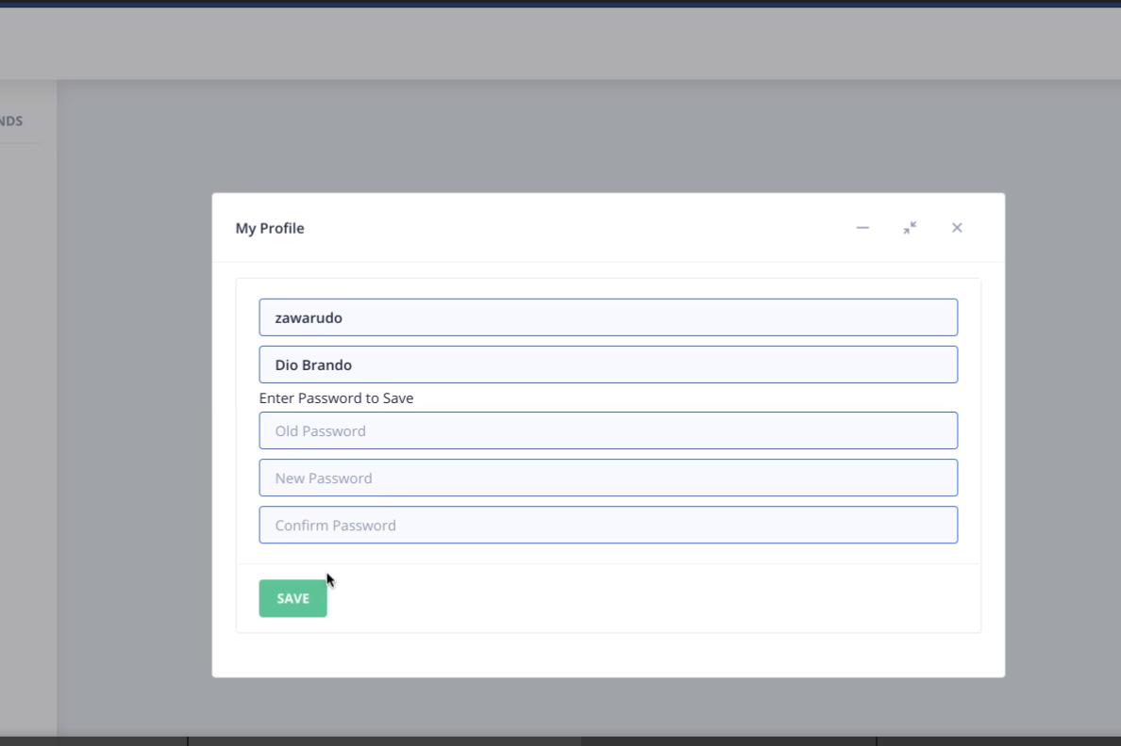
Profile Update

Slide 11
THANK YOU !

